Slide 1


Adversary Emulation Framework
Mentors: Dr. Alcides Alvear Suarez & Robel Campbell
Integrants: Kiara Rivera, Genesis Resto, Carlos Roque
Date: April 27th, 2023

Slide 2

Problem Definition
In the current state of anti-malware systems, defenders focus on a broad understanding of modern malware evasion techniques that their systems have the capability to detect, but the knowledge gap between malicious actors and security engineers makes these systems look frail.
G. Resto, K. Rivera, C. Roque Adversary Emulation Framework
2

Slide 3

Solution
G. Resto, K. Rivera, C. Roque Adversary Emulation Framework
3

Slide 4
Command and Control Framework
Dynamic Evasion – Variable Syscalls, ETW/AMSI Patching
In-memory Execution – Download Cradles, Microcontroller
Encrypted Payloads – AES-256, XOR
G. Resto, K. Rivera, C. Roque Adversary Emulation Framework
4

Slide 5
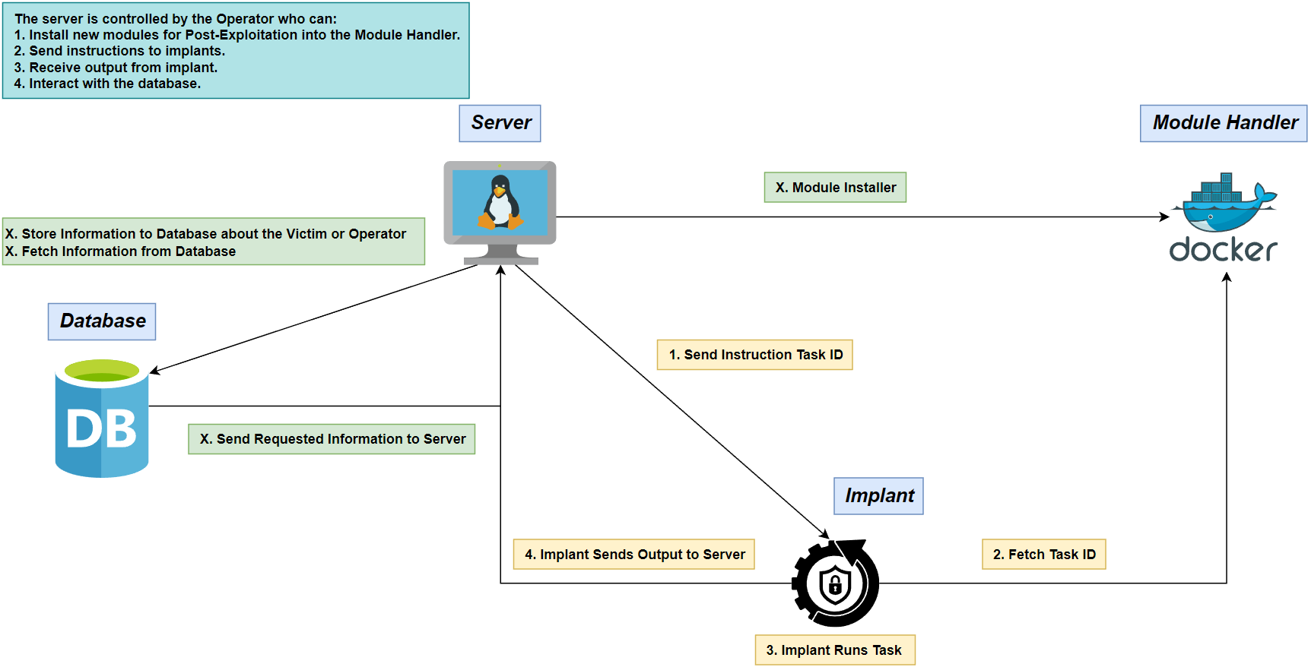
Concept Diagram
G. Resto, K. Rivera, C. Roque Adversary Emulation Framework
5

Slide 6
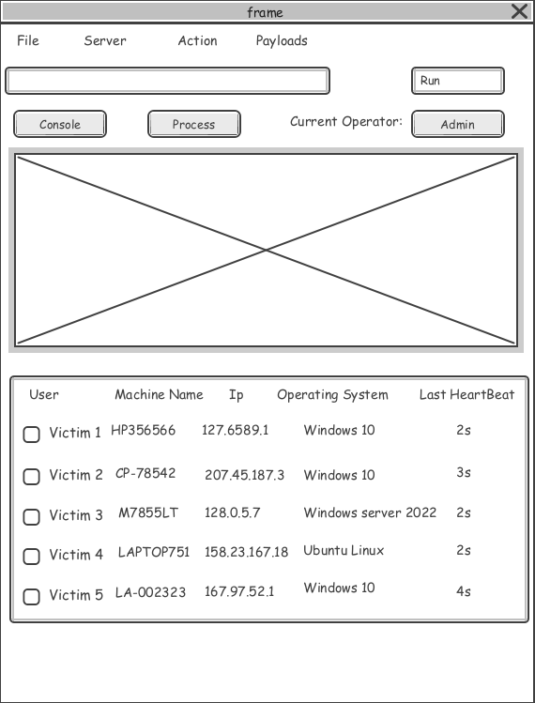
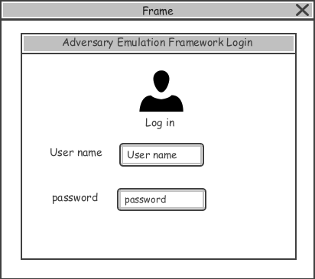
Wireframes
G. Resto, K. Rivera, C. Roque Adversary Emulation Framework
6

Slide 7
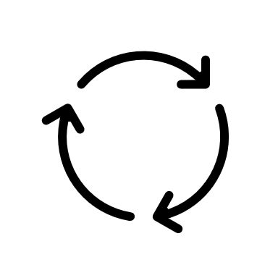
Flowcharts
G. Resto, K. Rivera, C. Roque Adversary Emulation Framework
7

Slide 8
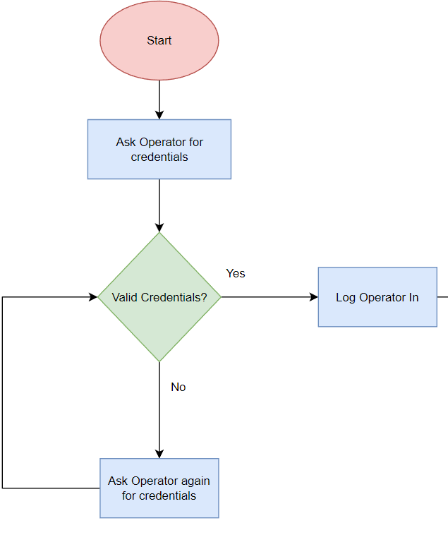
Login
G. Resto, K. Rivera, C. Roque Adversary Emulation Framework
8

Slide 9
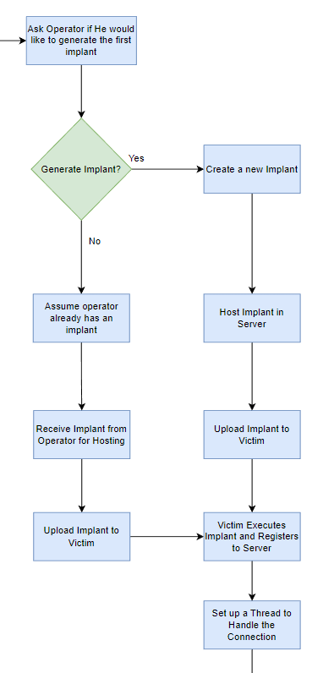
Dashboard Operations
9
G. Resto, K. Rivera, C. Roque Adversary Emulation Framework

Slide 10
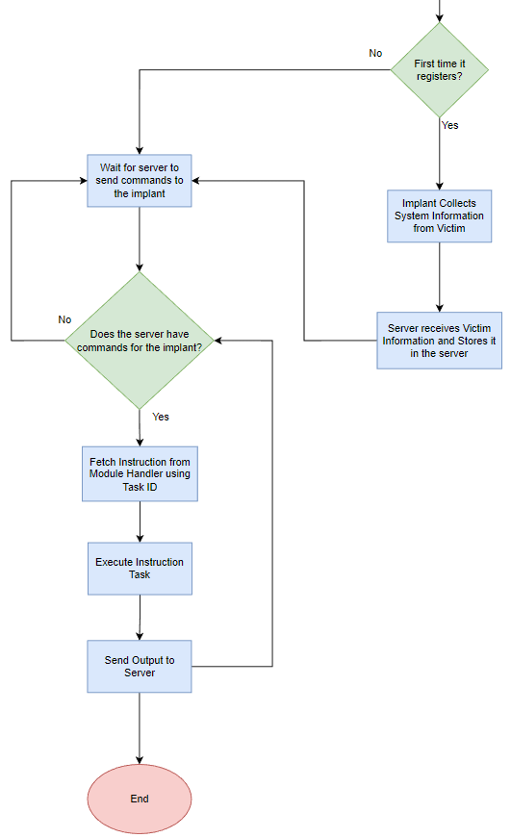
Implant Management
10
G. Resto, K. Rivera, C. Roque Adversary Emulation Framework

Slide 11
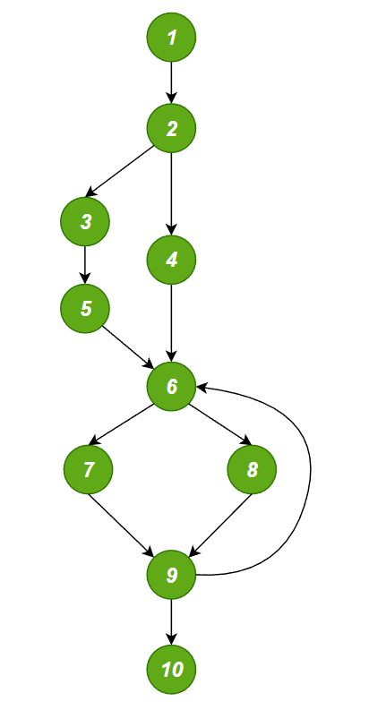
Cyclomatic Complexity
Flow Graph
V(G) = Edges – Nodes + 2 = 12 – 10+ 2 = 4
V(G) = Regions = 4
V(G) = Predicate Nodes + 1 = 4
Independent Paths:
1-2-4-6-7-9-10
1-2-3-5-6-7-9-10
1-2-4-6-8-9-10
1-3-5-6-7-9-6-8-10
1-2-4-6-8-9-8-9-10
G. Resto, K. Rivera, C. Roque Adversary Emulation Framework
11

Slide 12
Test Cases
Paths | Test Cases | Results
1 | Operator sets up his own implant and register it. | Program will receive operator’s implant and host it. On execution, it will register device to the database, receive an instruction from the server and then exit
2 | Operator generates implant from the server’s template and register it. | Program will set up a default implant and generate it for hosting. On execution, it will register device to the database, receive an instruction from the server and then exit
3 | Operator sets up his own implant. | Program will receive operator’s implant and host it. On execution, it will receive an instruction from the server and then exit
4 | Operator generates implant from the server’s template, register it and control it until he stops. | Program will set up a default implant and generate it for hosting. On execution, it will register device to the database, continually receive an instruction from the server and only stop when operator decides to.
5 | Operator sets up his own implant and control it until he stops. | Program will receive operator’s implant and host it. On execution, it will continually receive an instruction from the server and only stop when operator decides to.
12
G. Resto, K. Rivera, C. Roque Adversary Emulation Framework

Slide 13
Prototype Demo
13
G. Resto, K. Rivera, C. Roque Adversary Emulation Framework

Slide 14
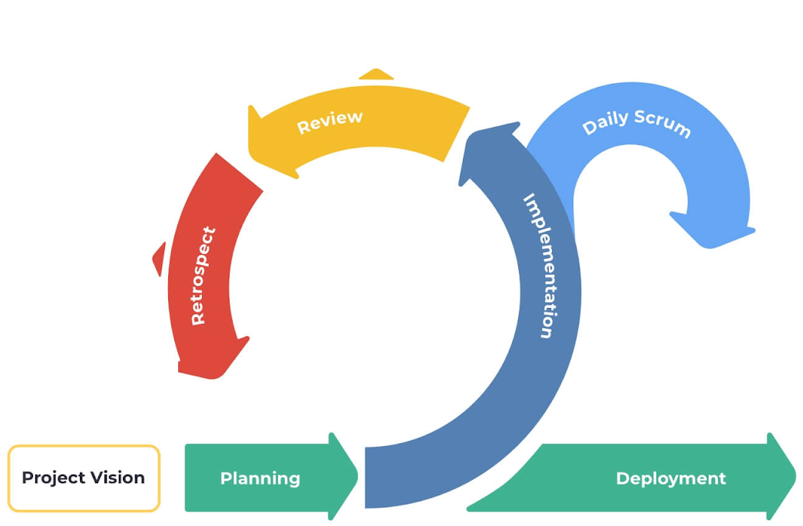






In the future…
What did we do well?
What did we not do well?
How can we improve?
What tasks did yesterday?
What tasks plans to work on next?
What issues was faced? (if any)
December 2023
14
G. Resto, K. Rivera, C. Roque Adversary Emulation Framework

Slide 15
References
Microsoft (2023, February). Dynamic Language Runtime Overview - .NET Framework. Microsoft Learn. https://learn.microsoft.com/en-us/dotnet/framework/reflection-and-codedom/dynamic-language-runtime-overview
G. Resto, K. Rivera, C. Roque Adversary Emulation Framework
15

Slide 16

Any Questions?
G. Resto, K. Rivera, C. Roque Adversary Emulation Framework
16

Slide 17

Thank you

